Slide 1
Youth Employment: What does good look like – A programme of change

Slide 2
Intent of this framework
This programme is intended to help employers understand what good youth employment looks like, where employers are on their journey, and to identify pathways forward. The focus is on the ‘rangatahi worker readiness’ of organisations, by championing and valuing the potential, skills and culture of young people. This captures how a business delivers processes and policies to provide an environment and culture that enables them and youth to thrive. By supporting employers on the 'what' and the 'how' of youth employment capabilities, we believe we can play an important role in enhancing the socio-economic outcomes of Tāmaki Makaurau and improve business productivity through quality work. The focus of this is on reducing unemployment and underemployment of rangatahi Māori and Pacific youth.
Kotahi Karihi nāna ko te wao tapu nui a Tāne
The creation of the forests Tāne comes from one kernel
Starting small leads to growth
Te Wharehuia Milroy

Slide 3
Getting prepared
There are changes coming. The future workforce will have an increasing number of Māori and Pacific youth under the age of 25. It is important to invest in building capability to understand and align expectations with rangatahi Māori and Pacific youth employees. This sets businesses up for success and provides the supports for Tamaki Makaurau to “grow its own people”. This programme of change doesn’t sit in isolation. By improving diversity and employee experience, this programme will support the social aspects of other accreditation ratings (B-Corp, ESG).
Advantages
Why
Getting prepared
20.5% of Auckland's workforce is currently made up of Māori and Pacific peoples, but this is forecast to increase to 37.5% over the next five years.
A diverse skillset, latest perspective and unique lived experience allows businesses to stay relevant to current societal trends and demands.
Address the skills shortage. Widen the talent pool – consider the talents and potential of a candidate.
Māori and Pacific peoples account for 40% of recent school leavers.
More than half of Māori and Pacific peoples living in Tāmaki Makaurau are under the age of 25.
Investing in rangatahi will allow businesses to retain great talent they have spent time attracting (reducing recruitment costs).
Loyal and adaptable groups of young people are keen to do their best and get their foot in the door to careers.
Nurturing diverse employees will improve engagement, productivity and innovation in businesses

Slide 4
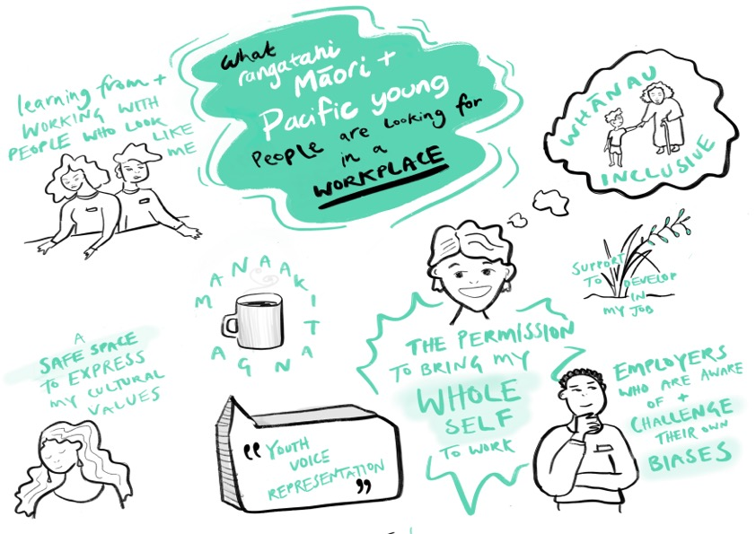
This might look like welcoming whānau into the interview process and, making whānau feel welcome when visiting the workplace.
Tuakana - teina mentorship through the onboarding process.
Representation matters especially at leadership levels – “if can see it, I can be it.”
Manaaki can be as simple as sharing kai together and taking the time to get to know them and their unique perspectives.
Transparent, proactive and regular communication about their development and career pathways.
More than ever, younger generations (such as Gen Z) expect their workplace to be diverse, inclusive and welcoming of young peoples’ whole selves, including their culture.
This might look like employers regularly undergoing bias training to understand unconscious biases and learn to mitigate them
A workplace that understands the role of whānau and culture in the wellbeing of rangatahi
Having rangatahi Māori and Pacific young people on employee feedback groups.

Slide 5
Elements of the programme of change
Framework
Toolkit
Reflection
Youth Employer Pledge
What is it
Foundational pou and principles to describe what being a good employer of rangatahi Māori and Pacific youth looks like
Digestible resources and insights employers can use to improve capability
Employer self-assessment and reflection process
A network of employers committed to growing their capability and credibility in employment of rangatahi Māori and Pacific youth
Foundations of the programme to provide employers of rangatahi Māori and Pacific youth with a high-level understanding of what good employment looks like in principle.
To assist employers of rangatahi Māori and Pacific youth to identify opportunities for growth, and access supporting resources to build maturity and capability.
To allow employers to easily understand where they are and to inform where and how they can develop further.
To deliver targeted intervention to provide employers with the support and information they need
To provide access to information, peer learning, connections, and action opportunities in a group environment.
To build credibility as a committed employer of rangatahi Māori and Pacific youth.
Purpose
Resources (examples, tips, case studies etc) relating to the 4 steps of the employment journey.
Pledge sign up information
Reflection output report
Measurement criteria
Targeted interventions and support
Commitment charter
Pledge levels
Events and networking
Content
3 Pou
9 Principles

Slide 6
Framework
Toolkit
Reflection
Informs
Links to
Guides
Creates
Using
Youth Employer Pledge
The YEP uses and upholds the three elements. Together, the three initiatives create a basket of knowledge that equips employers with skills, understanding, tools, and insight to be prepared for change.

Slide 7
Implementing Change
The programme of change allows for employers to build an understanding of what it means to be a good employer of rangatahi Māori and Pacific youth in Tāmaki Makaurau Auckland.
Manaakitanga
Three guiding pou The pou are pillars and provide principles to understand what being a good employer looks like.
Recruitment & onboarding
Preparing to recruit
Mana Tangata
Supporting new staff
Developing your staff
Four youth employer journey stages These are tangible and specific situations relevant to employers, showing how the pou can be applied in practice.
Ako
While the pou and the journey stages are shown separately, they do overlap significantly.
This multi-faceted framework allows for multiple entry points for employers to think about their own capability from the perspective that makes most sense to them.

Slide 8
The Framework
The framework describes what being a good youth employer of rangatahi Māori and Pacific Youth looks like.
The intention is for the pou to form the basis of recruitment, retention or development strategies. The principles can inform specific practices in a business. Using the framework can help employers to implement change through process and policies that deliver better youth employment outcomes for both business and rangatahi
3 guiding pou: Manaakitanga, Ako, Mana Tangata
9 principles: Recognising talent, belonging, wellbeing, data collection, strategic direction, cultural competency, youth voice, goals and aspirations, and feedback loops.

Slide 9
The guiding pou
Three guiding pou represent core values and foundations for good practice relating to the employment of rangatahi Māori and Pacific youth.
“Recognising and acknowledging rangatahi as taonga (treasure).”

Slide 10
The Principles
Nine principles underpin the three guiding pou and provide detail about what being a good employer of youth looks like in practice.
Manaakitanga
Mana Tangata
Ako
Recognising Talent
Recruitment and promotional practices are based on ability, skills and talent. Recognising where rangatahi are at and what level of support is needed to succeed.
Data collection ​
Collecting and analysing data relevant to rangatahi employment to support informed interventions and improvements.
Youth voice​
Enabling opportunities for rangatahi to contribute and be heard within the business, individually and collectively.
Belonging
Creating and maintaining a sense of belonging for rangatahi through the development of workplace culture and practices.
Strategic direction
Incorporating rangatahi employment directives from the top down to shape organisational practices.
Goals and aspirations
Understand and facilitate opportunities for growth through training, experiences and networks. Building aspirations and motivation for progression.
Wellbeing
Intentional actions to support the holistic wellbeing of rangatahi in the workplace.
Cultural Competency
Establishing learning pathways for current employees to better understand rangatahi and their unique cultural backgrounds, experiences and obligations.
Feedback loops ​​
Processes that support strong feedback to rangatahi, ensuring they are on track with clear expectations and guidance.

Slide 11
Manaakitanga
Examples of actions to be taken
What might good look like?
Recruit in a way that is transparent and accessible to all.
Use skills-based recruitment (internal and external) practices, that eliminate bias.
Tailored and targeted recruitment for rangatahi.
Recognise possible barriers and remove them.
Provide support throughout the recruitment process – setting out expectations.
Use different recruitment and interview methods that work for rangatahi (allow for a support person to attend).
Review JDs and job specifications to remove any unnecessary expectations.
Recognising Talent
Recruitment and promotional practices are based on ability, skills and talent. Recognising where rangatahi are at and what level of support is needed to succeed.
Creating a workplace where rangatahi culture, language, knowledge and community are affirmed and valued.
Create a work environment where people can bring their whole selves to work.
Recognise the importance and use of pronouns
Building trusting relationships by getting to know your rangatahi and their whanau.
Offering mentoring or a buddy or cultural groups.
Belonging
Creating and maintaining a sense of belonging for rangatahi through the development of workplace culture and practices.
Wellbeing
Intentional actions to support the holistic wellbeing of rangatahi in the workplace.
Make clear during the onboarding process and after the supports available both internally and externally.
Recognising and implementing culturally appropriate health models.
Offer flexible working options.
Promote good health and safety practices including mental health.
Consider providing pastoral care for those that need additional support.
Using the Te whare tapa whā or Fonofale models for wellbeing.
Some content adapted from: https://www.youthemployment.org.uk/dev/wp-content/themes/yeuk/files/good-youth-employment-charter-sep-2020.pdf

Slide 12
Mana Tangata
Examples of actions to be taken
What might good look like?
Data collection ​
Collecting and analysing data relevant to rangatahi employment to support informed interventions and improvements.
Detailed workforce data is gathered and regularly reviewed and used to identify and implement change.
For SMEs – keeping good records, understanding and getting to know your staff.
Know who works for you – pay, role, age, length of employment etc.
Regulatory review the data to look for opportunities to employ rangatahi.
Review your pay and rewards structure, in line with the data, across the whole business.
Strategic direction
Incorporating rangatahi employment directives from the top down to shape organisational practices.
Have intentional policies/procedures that relate specifically to rangatahi – including attraction, hiring, retention and growth
There are multiple entry points and roles to your business for rangatahi e.g., entry level, graduate, intern.
Employing youth is recognised as a priority at a strategic level.
Be a living wage employer and set pay scales in line with other employers.
Cultural Competency
Establishing learning pathways for current employees to better understand rangatahi and their unique cultural backgrounds, experiences and obligations.
Offering online or face-to-face courses for staff to learn about Te Tiriti o Waitangi, history of Aotearoa, Te Ao Māori, Pacific cultural practices, history of Pacific peoples in Aotearoa.
Staff members have an understanding of youth culture, perspective and expectations.
Staff are able to show clear understanding of the impacts of NZ history on Māori and Pacific peoples.
Understand what being a good treaty partner is.
Understanding of what different cultural obligations look like and have policies in place to cater for these.
Some content adapted from: https://www.youthemployment.org.uk/dev/wp-content/themes/yeuk/files/good-youth-employment-charter-sep-2020.pdf

Slide 13
Ako
Examples of actions to be taken
What might good look like?
Youth voice​
Enabling opportunities for rangatahi to contribute and be heard within the business, individually and collectively.
Rangatahi have the opportunity through different channels to effectively contribute to the organisation.
Youth voice forums.
Youth representative on board or executive teams.
Co-create opportunities with rangatahi that provide them with responsibility to lead and be challenged.
Goals and aspirations
Understand and facilitate opportunities for growth through training, experiences and networks. Building aspirations and motivation for progression.
Offer quality learning experiences that improve employability skills and promote career aspirations (both internally and externally).
Build capability of people leaders to effectively engage with rangatahi.
Co-designed career progression and pathways.
Provide opportunities for both internal and external training and development.
Provide a range of development opportunities that meet the needs of a diverse group.
Feedback loops ​​
Processes that support strong feedback to rangatahi, ensuring they are on track with clear expectations and guidance.
Provide multiple opportunities for rangatahi to share their ideas and provide and receive feedback.
Provide constructive feedback throughout including the recruitment process.
Have regular catch ups with line managers and regular personal reviews.
Have mechanisms that allow company feedback to gathered through safe channels.
Some content adapted from: https://www.youthemployment.org.uk/dev/wp-content/themes/yeuk/files/good-youth-employment-charter-sep-2020.pdf

Slide 14
The Toolkit
Resources to support employers on what to improve, and how to improve business outcomes by upskilling and building capabilities when attracting, hiring and retaining rangatahi Māori and Pacific youth.

Slide 15
Self- reflection guidance
Work / career milestones
How might your world view impact your practice?
For business owners, managers, HR professionals and others, part of preparing for change is understanding yourself and how your perspective on the world may influence who you hire, how you hire, and the environment you create within your business.
You can use this tool to help examine your world view, assumptions, and what to do with this knowledge.
Socio-economic position
Preferences
Gender
Age
Sketch yourself in the middle of this circle
You can represent yourself in any way you want. For example, you may draw an outline of yourself and use symbols that are meaningful to you. Consider how your culture and experience intersect with who you are. You can use symbols only you understand.
Answer the questions on the following page
Ethnicity
Sexuality
Experiences
Education

Slide 16
What preconceived ideas or assumptions do I have about hiring youth?
How might these preconceived ideas or assumptions impact on my ability to listen neutrally?
How might my experiences and different aspects of my identity impact on my ability to understand the changing workforce?
What can I do to minimise the impact of my assumptions on my employment practices?

Slide 17
Youth employment journey stages
WHY IT’S IMPORTANT:
Getting the conditions right before rangatahi Māori and Pacific youth arrive
ensures the culture and environment is prepared to receive them, setting everyone up for success. This allows them to thrive in sustainable careers while allowing you to have engaged employees.
WHY WOULD YOU ENTER AT THIS POINT
Set your business up for success by future-proofing for the rangatahi Māori and Pacific youth workforce:
Looking to grow and attract new employees that can contribute to the success of your business
Develop policies, procedures, and practices to create a culture that will attract and retain rangatahi Māori and Pacific youth.
WHO IS INVOLVED:
Leadership team
Human resources & People and Diversity
Marketing / Communications
Hiring managers
WHY IT’S IMPORTANT:
Connecting authentically and providing transparent and accessible processes will attract a diverse skillset and mindsets. Allowing clear guidance and shared expectations to be set up establishes the foundations for a trusting relationship.
WHY WOULD YOU ENTER AT THIS POINT
Bring in the latest skills, knowledge and perspective of rangatahi Māori and Pacific youth:
Understanding the current rangatahi Māori and Pacific youth job market needs and wants
Align your expectations and understanding of rangatahi Māori and Pacific youth
Increase applicants and attract a diverse group of potential employees.
WHO IS INVOLVED:
Hiring managers
Human Resources & People and Diversity
Grad and intern program owners.
Preparing to recruit Getting your business ready for youth to join
Recruitment & onboarding Removing barriers to create accessibility and transparency
Preparing to recruit
Preparing to recruit
Recruitment & onboarding
Recruitment & onboarding
Preparing
to recruit
Developing your staff
Key elements of this phase LANGUAGE, METHOD, EASE, TRUST, WHĀNAU
Developing your staff
Supporting new staff
Key elements of this phase CULTURE, THRIVE, ENVIRONMENT
Supporting new staff

Slide 18
Youth employment journey stages
WHY IT’S IMPORTANT:
Allowing your rangatahi Māori and Pacific youth to bring their whole self, building a mutual understanding while creating a sense of purpose and belonging results in an engaged and productive workforce.
WHY WOULD YOU ENTER AT THIS POINT?
To get the possible start for your employee through providing the tools they need to thrive
To understand how to get the best from your rangatahi Māori and Pacific youth
Wanting to establish positive relationships with rangatahi Māori and Pacific youth to ensure they want to contribute and stay engaged in the work place
Set them and you up for success.
WHO IS INVOLVED:
Line managers
Peers
Mentors and coaches.
People and Diversity
WHY IT’S IMPORTANT:
By challenging rangatahi Māori and Pacific youth people to upskill, it allows both the business and its people to grow and be agile.
WHY WOULD YOU ENTER AT THIS POINT?
Employees have established themselves in the organisation, you recognise their value and skillset and you want to support them to grow and set new challenges
Building engagement and retention of your rangatahi Māori and Pacific youth workforce, finding alternative solutions to fill your skills gap.
Recognising, training and promoting rangatahi Māori and Pacific youth staff internally.
Encouraging rangatahi to take other opportunities outside your organisation to grow and process.
WHO IS INVOLVED:
Line managers
Senior leaders
Mentors and coaches.
Supporting your staff Establishing relationships and building the foundations for success
Developing your staff Inspiring and motivating rangatahi Māori and Pacific youth staff by providing growth opportunities
Supporting new staff
Preparing to recruit
Preparing to recruit
Recruitment & onboarding
Recruitment & onboarding
Developing your staff
Supporting new staff
Key elements of this phase ENGAGEMENT, CHALLENGE, AGILITY
Developing your staff
Supporting new staff
Key elements of this phase BELONGING, RELATIONSHIP-BUILDING, HOLISTIC
Developing your staff

Slide 19
Toolkit Example: Preparing to recruit
Snapshots
Anecdotes from employers about how they prepared to recruit rangatahi Māori and Pacific youth.
In depth case studies Relevant case studies from employers focused on preparing to recruit rangatahi Māori and Pacific youth.
Top 5 things you can do The top 5 tips to get you started when it comes to preparing to recruit rangatahi Māori and Pacific youth.
Development programmes Sign up to the available programmes to better prepare for recruiting rangatahi Māori and Pacific youth.
Who can help Links to relevant organisations who may be able to assist you at this stage.
Guidelines Repository of relevant guidelines about preparing to hire rangatahi Māori and Pacific youth.
Youth Voice
Anecdotes from rangatahi Māori and Pacific youth on what works
for them in the workplace.

Slide 20
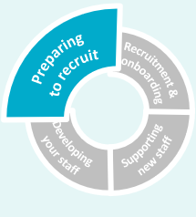
Toolkit Example: Preparing to recruit – Top Tips
Create a welcoming process that takes into consideration their culture, e.g. powhiri, welcoming whānau.
Have a mentor available who they can relate to and can understand their culture.
Have a recruitment process that identifies and tries to eliminate bias
1
2
3
Ensure there is support for managers to understand how to build a trusting relationship that recognises and accepts cultural differences.
Connect with organisations that specialise in rangatahi Māori and Pacific youth or diverse recruitment companies.
Ensure there is a diversity or people policy/strategy that identifies rangatahi Māori and Pacific youth as a priority.
4
5
+

Slide 21
Toolkit Example: Recruiting and onboarding
Snapshots
Anecdotes from employers about how they prepared to recruit rangatahi Māori and Pacific youth.
In depth case studies Relevant case studies from employers focused on preparing to recruit rangatahi Māori and Pacific youth.
Top 5 things you can do The top 5 tips to get you started when it comes to preparing to recruit rangatahi Māori and Pacific youth.
Development programmes Sign up to the available programmes to better prepare for recruiting rangatahi Māori and Pacific youth.
Who can help Links to relevant organisations who may be able to assist you at this stage.
Guidelines Repository of relevant guidelines about preparing to hire rangatahi Māori and Pacific youth.
Youth Voice
Anecdotes from rangatahi Māori and Pacific youth on what works
for them in the workplace.

Slide 22
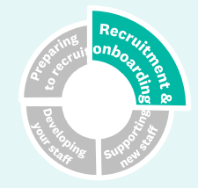
Toolkit Example: Recruitment & Onboarding - Snapshots
“Thinking about different pathways or entry points into our organisations give us the opportunity to access different skills and not relent on qualifications.”
- Employer
“Having a chat rather than an interview makes it much less scary” – Rangatahi
More snapshots coming soon… email us with a short snapshot of something you’ve done to improve in this area at TAU@Aucklandcouncil.co.nz
“Allowing me to bring along my Matua (uncle) to my interview gave me confidence and felt the company wanted to know more about me ” - Rangatahi
“Changing our recruitment partners to those who specialise in engaging Māori, means we now get greater diversity in our applicants” – Employer

Slide 23
The Youth Employer Pledge
The Youth Employer Pledge (the Pledge) is a collective of Tāmaki Makaurau-based employers and key stakeholders who are dedicated to improving their capability as employers of young people, particularly rangatahi Māori and Pacific youth.

Slide 24
What is the Youth Employer Pledge?
Signing up to the Pledge is free and shows a commitment to change and progression based on the pou. Becoming a member is taking time to reflect on where you are on your journey, and understanding and committing to the changes you can make to provide quality and sustainable career opportunities for rangatahi. To ensure that our rangatahi are going into quality employers that are committed to making that change, we have three tiers that demonstrate the level of maturity of organisations. However, we ask of all employers to be committed to the following to be part of the Pledge whanau at any level:
Tuakana (Organisations who are youth employment leaders)
Commitment:
To pay Rangatahi the living wage either now, within 3 years, or following the completion of an apprenticeship or training scheme
Be able offer training and career progression opportunities for all rangatahi
Have a dedicated Youth Employer Pledge representative in their organisation and succession plan
Committed to attending and participating at the Pledge events and networking opportunities
Committed to making change and progression based on the pou
Teina (Organisations who are committed, accountable, and growing in maturity)
Tupu (Organisations or individuals who are interested in upskilling)
Taupuhipuhi: Supporting organisation who are essential to the eco-system eg EMA, MoE, TSI

Slide 25
Collective Charter Commitments
Behaviour and Mindset on display
The business is growing and/or has a turnover of staff which facilitates the active hiring of rangatahi Māori and Pacific youth.
The business has clearly defined development opportunities or pathways for rangatahi Māori and Pacific youth employees to grow into
The organisation demonstrates a growth mindset by having innovative and reflective employment practices in place
The business is committed to building a diverse and inclusive workforce more broadly (in your business/organisation)
Employers see rangatahi Māori and Pacific youth as taonga (treasure) to be invested in and nurtured
Employers are courageous and feel empowered to help themselves and build capability to adapt.
Commitments which can be demonstrated
Active sharing of exemplars with TAU and the YEP network – hiring practices, welcoming/onboarding, etc. This could take the form of writing a case study, or being interviewed by the TAU team
Event attendance and participation
Continuous Improvement – reviewing, updating, improving practices related to employing rangatahi Māori and Pacific youth in the business
Willing to be innovative and be part of future pilot projects
A clear mandate/purpose/strategy/(committed) to have diverse hiring practices
A clear pathway for rangatahi Māori and Pacific youth representation in higher positions with mechanisms to provide a culturally safe environment for feedback and engage in organisational decisions
Training and support is available for those that are hiring and working with rangatahi Māori and Pacific youth to improve practices.

Slide 26
Benefits​ Join a network of employers that are committed to change through a growth mindset ​ Build relationships with key stakeholders that work directly with rangatahi Access to a toolkit of resources designed to be easy to engage with, providing practical solutions that can be implemented​ Support the development of effective D&I strategies and processes to improve practices when working with rangatahi​ Be part of events and workshops that encourage thought leaders to tackle shared challenges Access the latest data, examples of best practice, trends and insights from TAU and other partners.​ Take part in regular self-reflection and receive reporting to track progress.​ Use of the Pledge brand to gain recognition of your accomplishments and attitude towards youth employment​
Mission and benefits of the Pledge
Value
The Pledge brings strength to the ecosystem through connections and relationships between key stakeholders and employers
The Pledge enables the system to learn from each other and leverage insights to share insignificant findings (e.g. member bodies)
The Pledge creates the conditions for organisational change by embedding innovative practices, not relying on individual relationships or ongoing funding.
The Pledge aims to bridge the perspectives and expectations between employers and rangatahi through enabling a work culture and experience in which rangatahi and employers can thrive

Slide 27
Progression of the Pledge
Tuakana (Organisations who are youth employment leaders)
Employers at the Tuakana level are at a level of excellence, the top level of commitment and maintaining exclusivity through a capped number of employers. These employers have a high degree of maturity, as demonstrated by policies, practices and implemented change. They represent a strong organisation-wide focus on employment of rangatahi Māori and Pacific youth through achieving excellence or significant growth across the action areas. They have a more direct connection to TAU for support.
Tuakana level pledge benefits
Support to conduct youth employment innovation experiments with case study promotion
Ability to be nominated for youth employer award
Access to all 4 annual pledge events
Instant access to paywall information
Expectations
Several people within the organisations take the self-assessment: rangatahi Māori and/or Pacific youth, CE/GM/senior leader.
TAU can come into Tuakana level organisations to have conversations with leaders.
Teina (Organisations who are accountable and growing maturity)
Employers at the Teina level are at an intermediate level of commitment and are learning from their Tuakana. Understanding and action has moved beyond an individual’s focus. The annual evaluation has been completed by representatives within the organisation, including rangatahi Māori and Pacific youth.
Teina level pledge benefits
Access to Pledge community and brand
Instant access to paywall information
Discounts available.
Annual performance report to track employer progress relative to others
Access to all 4 annual pledge events
Expectations
A few people within the organisation take the self-assessment, including youth employees.
TAU can meet with Teina-level organisations to have conversations with leaders.
Tupu (Organisations or individuals who are interested in upskilling)
Employers or stakeholder at the Tupu level are just beginning their journey to committing to young employment excellence - the base level of commitment. An individual or individuals within an organisation have made an effort to understand how they might improve their current practices to better support youth employment outcomes through the benchmarking evaluation. Self- guided support.
Tupu Pledge benefits:
Access to supporting resources
Access to Pledge newsletters and webinars
Access to 2 free pledge events
Expectations
Individuals who register to become part of the Pledge as a Tupu member share some data about their business during sign up.

Slide 28
Measurable criteria
Criteria | Tupu | Teina | Tuakana
Youth workforce
Rates of youth employees being hired | 10% of new staff under 30 | 15% of new staff under 30 | 25% of new staff under 30
Retention: Rates of youth employees staying beyond 6 months, 1 year, 3+ | Retention unknown or low | ^ 70 % retention 1 year ^ 60% 2 years ^ 50% 3 years | ^ 80 % retention 1 year ^70% 2 years ^ 60% 3 years
Ethnicity of youth employees being hired and the level of the workforce they are positioned in |  | 30% Māori and Pacific young staff in roles above entry level | 40% Māori and Pacific young staff in roles above entry level
Data: know your staff. Age, job title, ethnicity, how long have they worked there | Plan in place to start collecting some of this data | Some of this data is collected | This data is collected regularly
Youth career development
Demonstrating commitment to development: Qualifications or Accreditations being added to CVs of youth employees. There are future career and development pathways created for each young employee. | Plan in place for young staff to attend development course after 1 year and to create plan. | Young employees attending ^ 1 courses within 1 year and or plan is in place for development | Young employees attending ^ 2 courses within 1 year and a clear plan is in place for young staff development.
Employment benefits
Pay rates: living wage at start date | Understanding what the living wage is and how it would it affect your business finances/model. | Living wage after start date | Paying young employees Living wage or above
Leave allowance – Tangihanga, whānau time | … | … | ..
Pledge commitment and accountability
YEP engagement: attendance at YEP events | Occasional attendance | Some attendance | Regular attendance
Experimentation: active projects within the business which aim to improve practices related to youth employment. i.e. re-writing of job descriptions and job advertisements in plain language; setting up a youth committee / representative role; etc. | Some ideas of what they would like to work on | Some improvement work in areas of the business
Representation – Youth voice, mechanism to contribute. Leadership without position | Plan in place to develop mechanisms for youth input to leadership-level decision-making | Some mechanisms for youth input to leadership-level decision-making | Strong mechanisms for youth input to leadership-level decision-making
Notes:
Criteria will be different across the three tiers of the across the tiers of YEP (Tupu, Teina and Tuakana) and those at the higher levels should be able to demonstrate greater maturity, capability, etc.

Slide 29
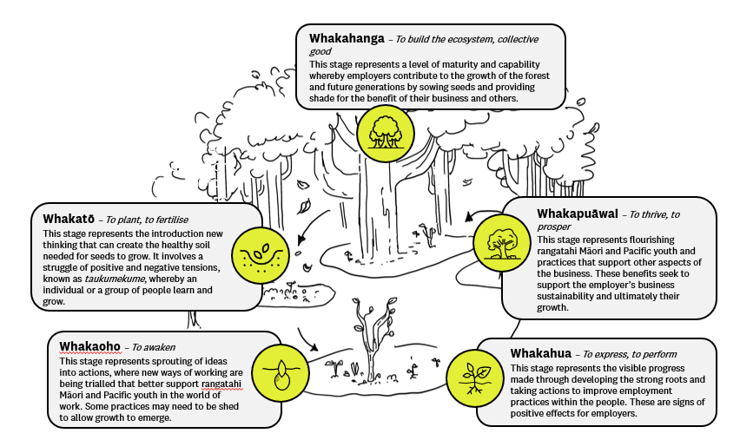
Employer maturity development cycle
Levels of employer capability in employment of rangatahi Māori and Pacific youth have been represented as stages of maturity from a seed to a tree. The aim of this metaphor is to support the why and the how of better employment for rangatahi Māori and Pacific youth, from creating the foundations to supporting the capabilities in others. No matter where an employer is on the journey, it can be celebrated and there can be growth. Through growing rangatahi Māori and Pacific youth, businesses can sow seeds for success.

Slide 30
Ngā mihi

